Slide 1

Using R as a Research Tool.
NERC E3 DTP Training – 28th November
Dr Susan Johnston, Institute of Evolutionary Biology
Demonstrators: Gergana Daskalova, John Godlee

Slide 2
Today’s session:
Write, embed and render code and results into an HTML document.
Carry out basic statistics and visualisations, including:
Chi-squared test with chisq.test()
2-sample t-test with t.test()
Linear regression with lm()

Slide 3
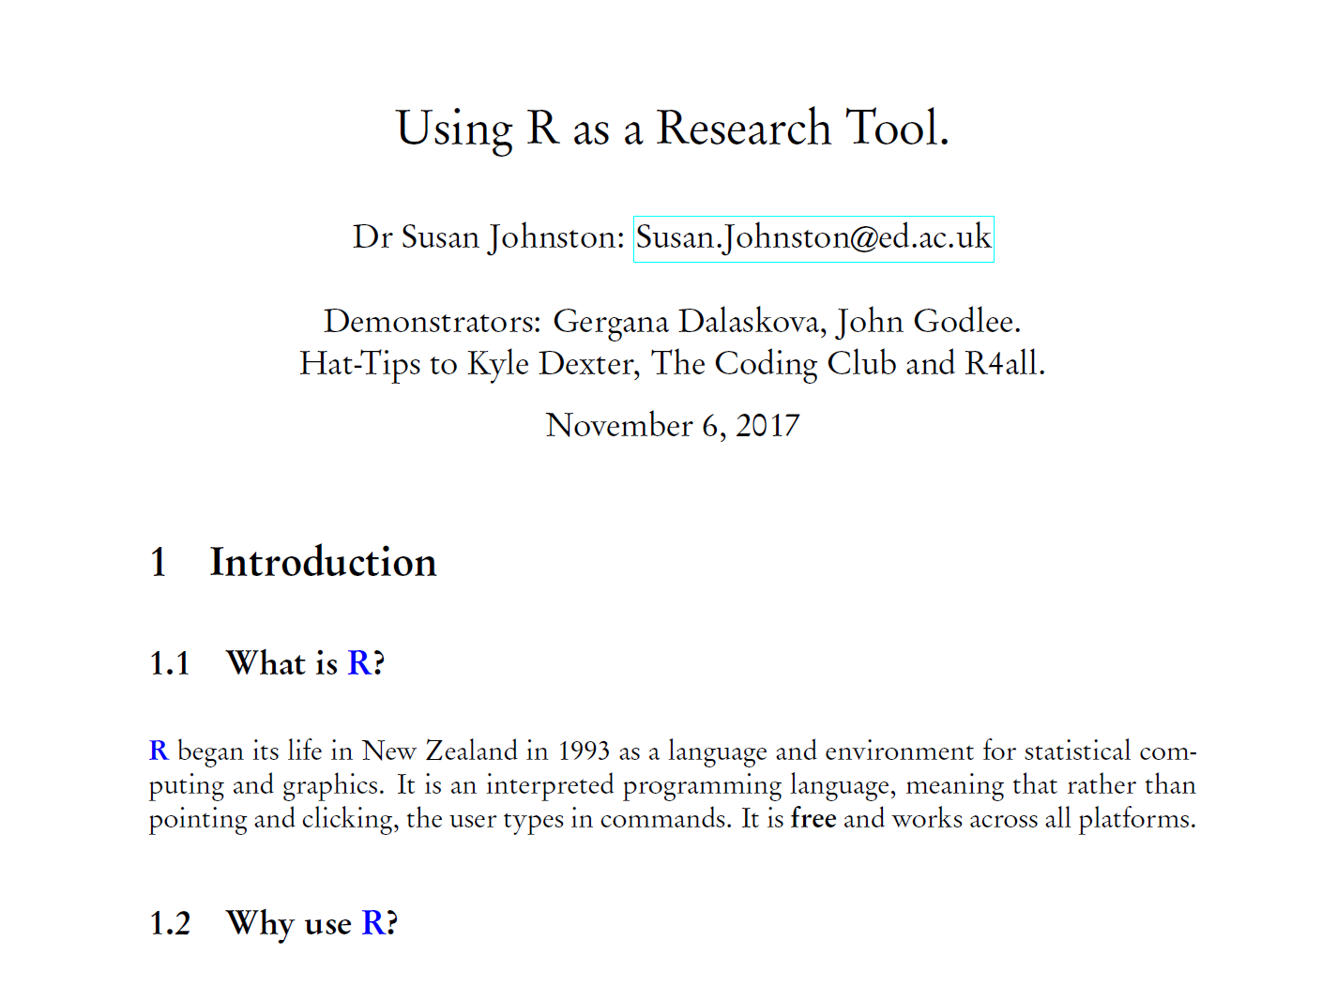
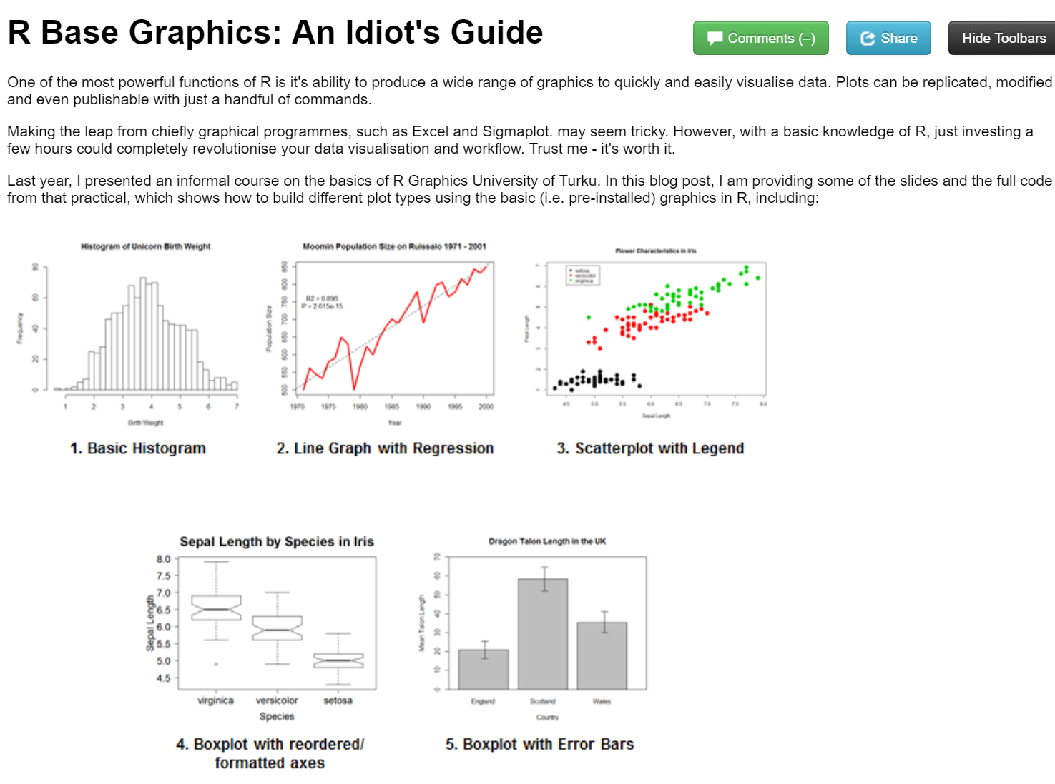
Report writing
LaTeX and R Sweave
knitr to HTML

Slide 4
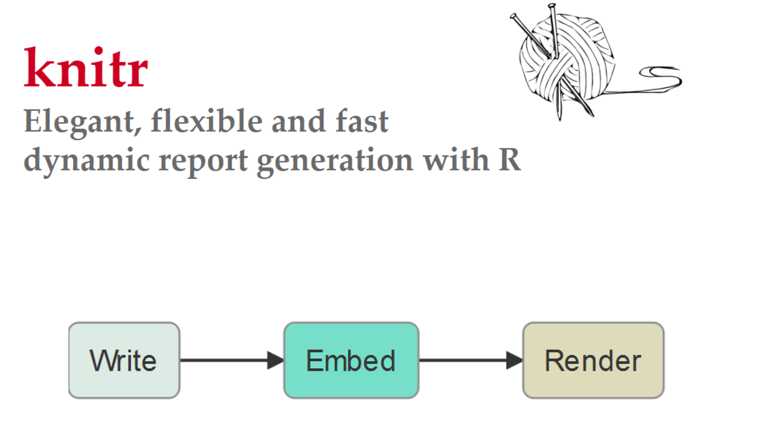
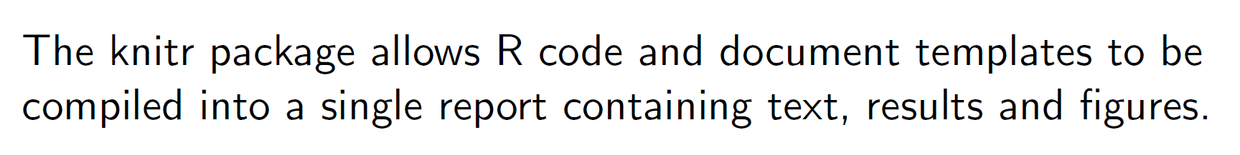

Slide 5
Worked example…

Slide 6
Today’s session:
Write, embed and render code and results into an HTML document.
Carry out basic statistics and visualisations, including:
Chi-squared test with chisq.test()
2-sample t-test with t.test()
Linear regression with lm()

Slide 7
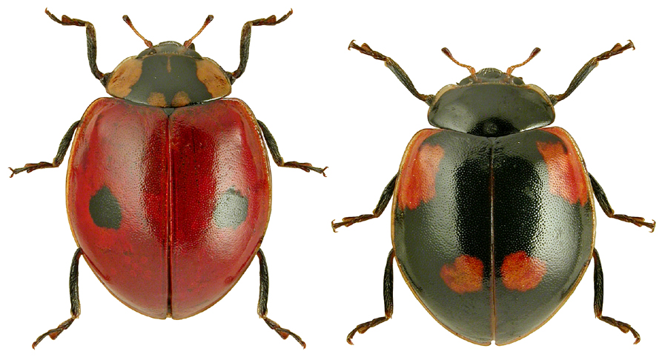
Chi-squared (χ²) contingency table
Analysis of count data
Are lark ladybirds more likely to live in industrial (dark) backgrounds?
Adalia bipunctata

Slide 8
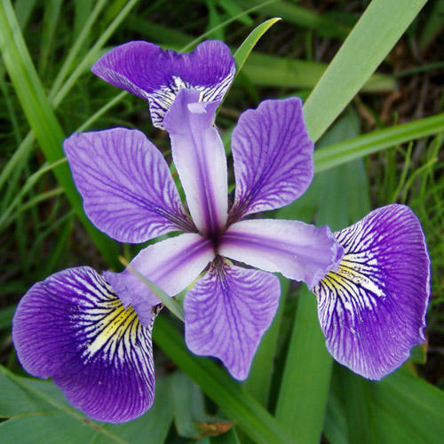
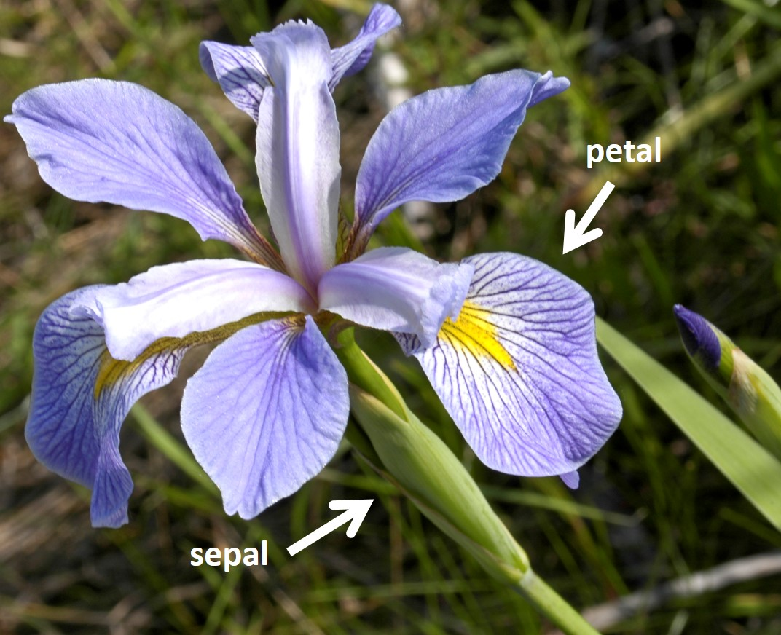
Two sample t-test
Compares the mean of two groups.
Are sepal lengths significantly different between these two species of Iris?
Iris versicolor Iris virginica

Slide 9
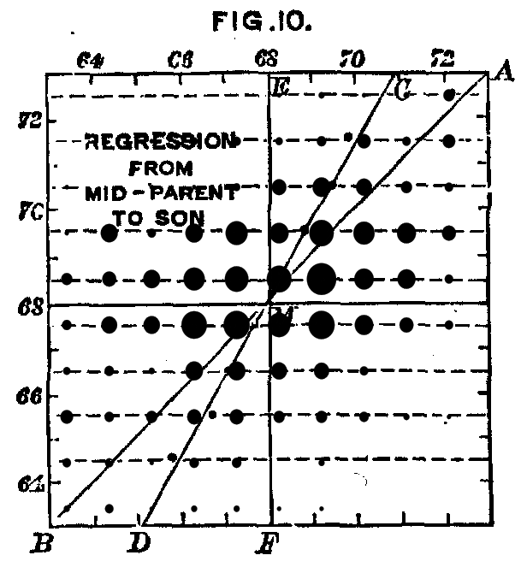
Simple linear regression
Summarise and study relationships between two continuous variables.
Francis Galton’s Human Height Data Set 1886
Does daughter height vary relative to the mean height of her parents?

Slide 10
Need help?
ASK US!
Use ?, str(), glimpse() to explore functions and objects.
Coding Club tutorials: https://ourcodingclub.github.io/tutorials/
Google & StackOverflow

